Slide 1
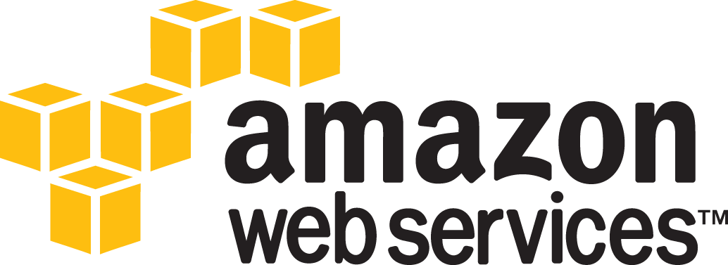

Slide 2
Contents
What is an Environment?
What is Cloud computing?
What is Amazon Web Services?
Elastic Compute Cloud
Virtual Private Cloud
Simple Storage Service
Cloud Formation

Slide 3
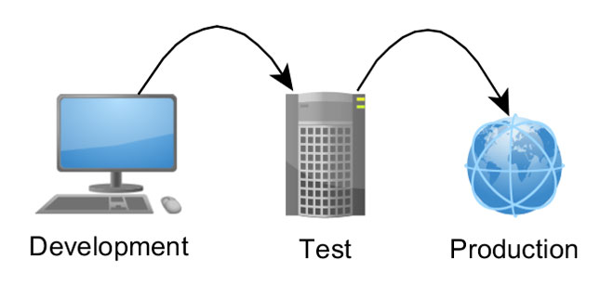
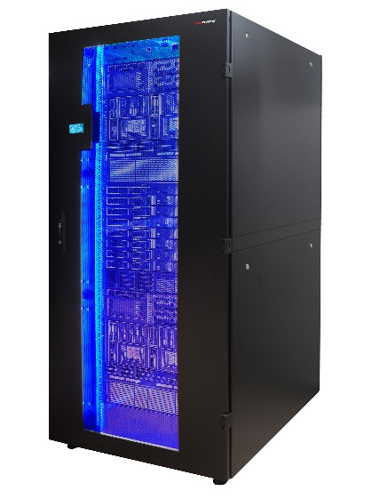
What is an Environment?
Overview
In software deployment, an environment or tier is a computer system in which a computer program or software component is deployed and executed.
Development
Working in isolation with the rest of the tiers, the developer(s) can try radical changes to the code without adversely affecting the rest of the development team.
Integration
A common environment where all developers commit code changes.
Combine and validate the work of the entire project team so it can be tested before being promoted to the Staging Environment.
Possible for Development and Integration to be the same environment
Staging/Test
Identical to the production environment as possible.
Simulate as much of the Production environment as possible
Production
Production tier might include a single machine or a huge cluster comprising many machines.
Notes:
Environment refers to the collection of hardware and software tools a system developer uses to build software systems.
The Development environment is where developers live and breathe, where they make all the changes, mistakes and fixes that you need. It’s like a small lab where nobody judges you, where it does not matter if you break the CSS or your whole webpage as nobody is going to notice. Once you achieve something, like developing a new item of a list, fix a bug, or a new functionality, you should stop and move your functionality to the Testing environment.
The Testing / Staging environment is a little different. Actually, there is a slight difference between testing and staging environments, but to distinguish them is not the point here. You need something that acts as a copy of your corporate site, a copy of the live version. It should be EXACTLY the same, because you are going to test in this environment your new developments, you want to know how it will work and IF it will work live before going live. Only once you have verified that everything works, that your new functionality has not broken anything, you can migrate the changes to the production environment.
Finally, the Production environment. It is the live version of your site / software. You should only use in this environment things that you are 100% will work and that have been tested. You should NEVER make changes in production directly. It sounds easy to follow but it isn’t. When you see that you can “fix” something easily in production, hold that thought. Even if it is just one line of code, don’t do it, test it before. Some of the reasons to ALWAYS follow this rule is that a small change can break things, and that if you skip one of this steps you risk creating glitches between your different environments which in turn will increase the possibility of new failures.
The number of places where this simple rule is not followed is still huge, and the worst of it all is that the reason in most cases is pure human laziness, not computational complexity.After all, it’s actually an easy to follow rule:
Experiment on the development environment, Test it on the Test environment and if it works Migrate the changes to the Production environment.

Slide 4
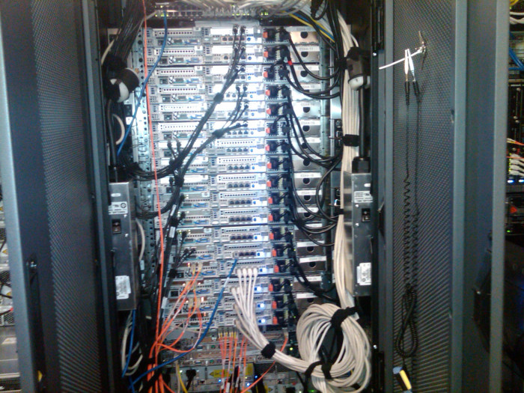
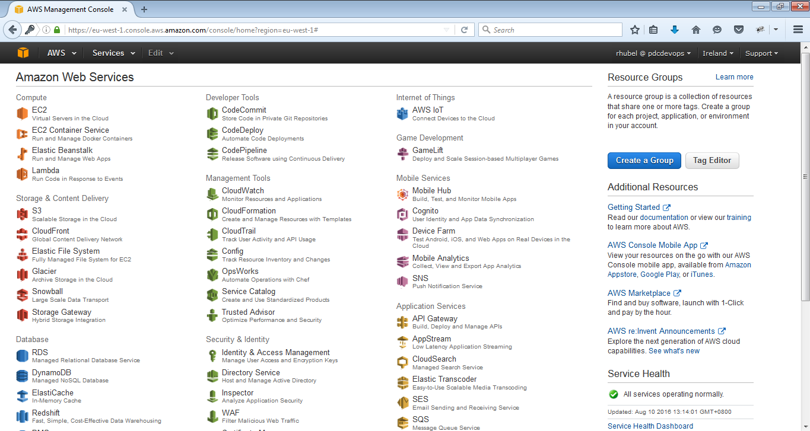
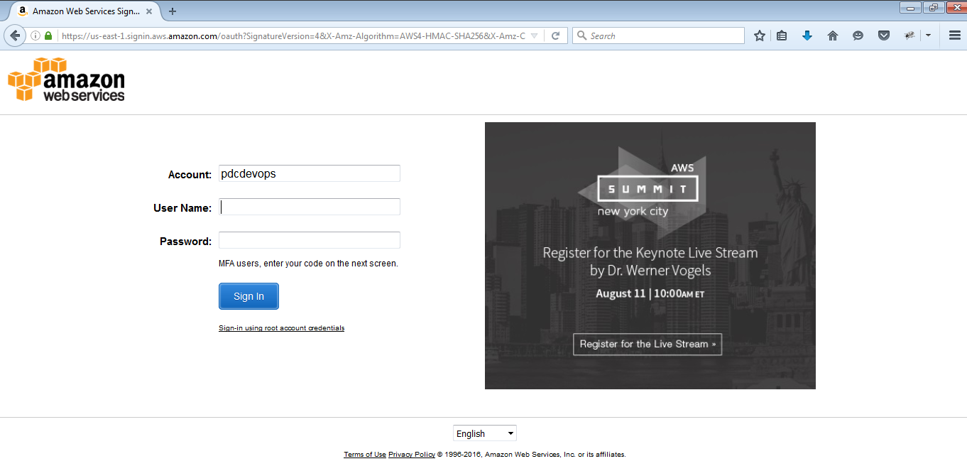
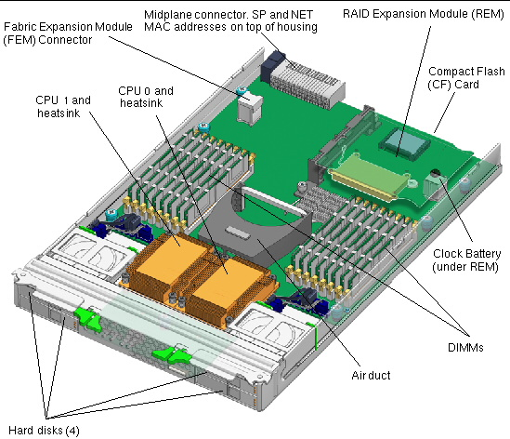
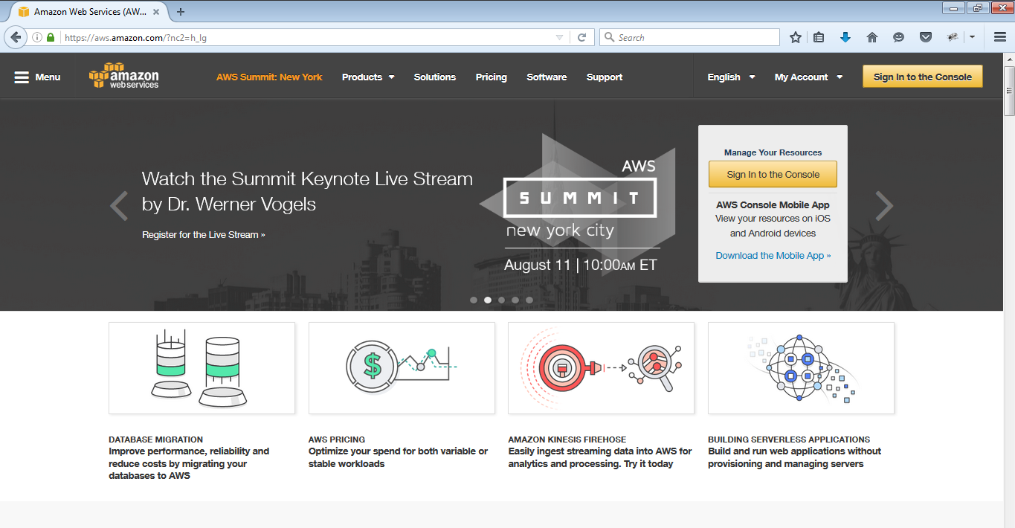
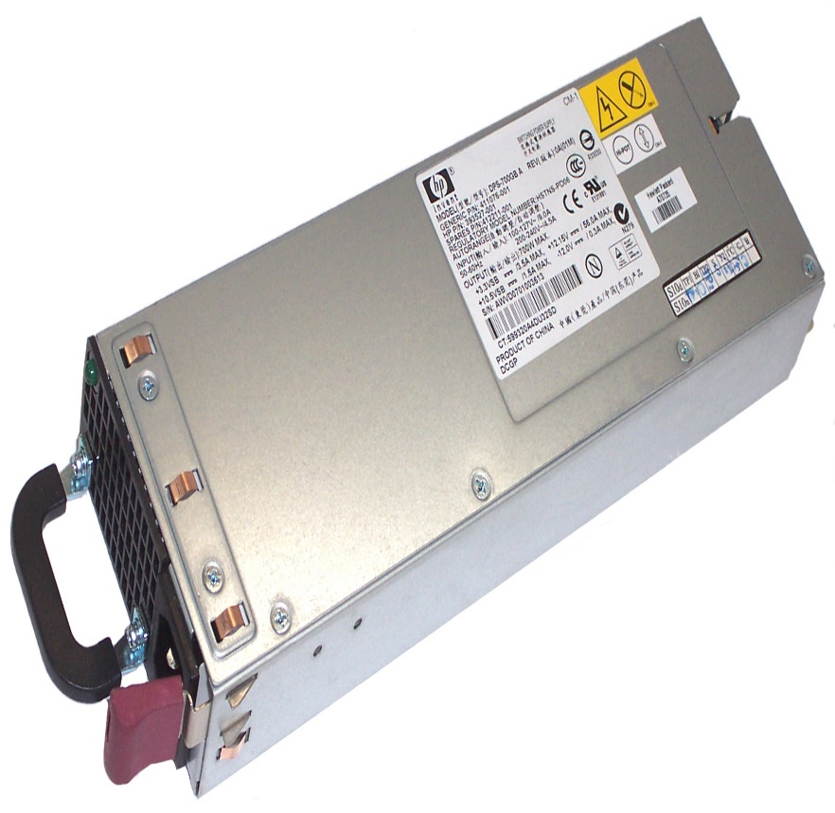
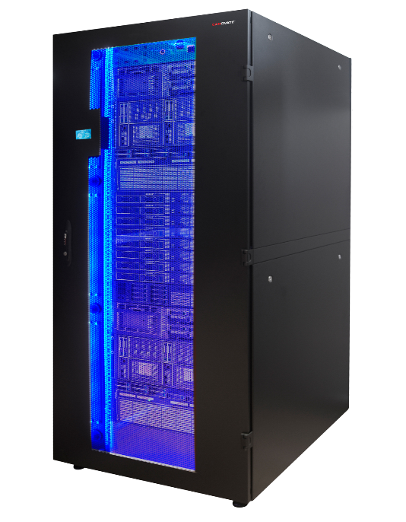



What is an Environment?
Overview
Traditional Hosting
Cloud Hosting
Notes:
Physical Servers
Getting a physical server involves several steps, as follows.
Once you hire us to get one, we call the hardware provider (Dell in our case) and wait for several days for the hardware to arrive at our offices in Sweden. With the hardware here, one of our technicians locate a free rack unit, install the server, connect the corresponding cables and power supply and after talking to the customer, the desired operating system is installed.
After a few basic diagnostics and with the operating system ready to go, users are delivered their credentials. After this, you can remotely access your server and start setting up whatever software you wish. At this point, control is up to you and we only intervene for reboots and hardware changes. Although once configured, this is a rare occurrence. The servers we use from Dell have great quality hardware, redundant disks and all kind of components built to last.
We take care, of course, of the network and make sure you have fast connectivity at all times. Top of the line Cisco routers and switches, redundant refrigeration and continuous power ensure you won´t get any hiccups under normal circumstances.
The server runs non-stop until the end of times, or until you decide to stop using it.
Virtual Servers
Virtual dedicated servers or Infrastructure as a Service as it´s commonly known is a way of having your own machine and while the end result is similar, the way to order one is different.
You start by registering an account (here at City Cloud), and when you have confirmed your email and identity, you get access to our control panel. From there, you just click on “New VM”, select the operating system and/or image (some of them come with pre-installed software ready to go) and wait a few minutes.
That´s right, after a few minutes you get a new virtual machine that can be accessed by SSH or VNC. The IP address is assigned automatically so you have everything you need to start installing software.
Servers run continuously until you turn them off, which can be done with literally one click. You can then clone them, erase them, turn them back on or just leave them paused.
Since you pay by the hour and by capacity, you can increase and decrease power and cost between minutes. Choice is really up to you or your application, since this can also be automated.
Reduced IT costs
Moving to cloud computing may reduce the cost of managing and maintaining your IT systems. Rather than purchasing expensive systems and equipment for your business, you can reduce your costs by using the resources of your cloud computing service provider. You may be able to reduce your operating costs because:
the cost of system upgrades, new hardware and software may be included in your contract
you no longer need to pay wages for expert staff
your energy consumption costs may be reduced
there are fewer time delays.
Scalability
Your business can scale up or scale down your operation and storage needs quickly to suit your situation, allowing flexibility as your needs change. Rather than purchasing and installing expensive upgrades yourself, your cloud computer service provider can handle this for you. Using the cloud frees up your time so you can get on with running your business.
Business continuity
Protecting your data and systems is an important part of business continuity planning. Whether you experience a natural disaster, power failure or other crisis, having your data stored in the cloud ensures it is backed up and protected in a secure and safe location. Being able to access your data again quickly allows you to conduct business as usual, minimising any downtime and loss of productivity.
Collaboration efficiency
Collaboration in a cloud environment gives your business the ability to communicate and share more easily outside of the traditional methods. If you are working on a project across different locations, you could use cloud computing to give employees, contractors and third parties access to the same files. You could also choose a cloud computing model that makes it easy for you to share your records with your advisers (e.g. a quick and secure way to share accounting records with your accountant or financial adviser).
Flexibility of work practices
Cloud computing allows employees to be more flexible in their work practices. For example, you have the ability to access data from home, on holiday, or via the commute to and from work (providing you have an internet connection). If you need access to your data while you are off-site, you can connect to your virtual office, quickly and easily.
Access to automatic updates
Access to automatic updates for your IT requirements may be included in your service fee. Depending on your cloud computing service provider, your system will regularly be updated with the latest technology. This could include up-to-date versions of software, as well as upgrades to servers and computer processing power.
The Pros and Cons of Physical Servers
A physical server is piece of equipment on which data is stored and read. This may be located onsite in your server room, or it could be stored at a colocation facility (a data center) with a trusted vendor. Physical servers are generally owned, managed, and maintained by your company's staff.
Pros of Physical Servers
Your IT team has full access to your dedicated server resources 24/7/365, which can be advantageous for high-demand or business-critical operations.
Depending on your needs, the server may be located onsite or in a conveniently-located colocation facility.
Your IT staff can fully customize and configure the server to your specifications and business requirements.
Cons of Physical Servers
Relatively high cost of server purchase, maintenance, and in the case of hardware failure, replacement.
Your IT staff will be responsible for setup, configuration, and maintenance on a continual basis.
You may need to hire a contractor or vendor for help if you have difficulty with configuration or repairs.
Users cannot scale storage in small increments once you reach the maximum workload, since you purchase and own the hardware.
Requires physical or colocation space.
The Pros and Cons of Virtual Servers
Virtualization is the act of placing multiple "virtual servers" on physical equipment. This allows physical server resources to be split between multiple workloads for maximum efficiency and cost savings. Virtualization typically occurs in the cloud or on servers that are owned, maintained, and located offsite. Hiring a hosting vendor who offers secure cloud services is the most common way that organizations switch to virtualization.
Pros of Virtual Servers
Fewer upfront costs, since you are not required to purchase hardware.
Potential for lower lifetime costs on configuration and maintenance.
Access to expert assistance on setup, configuration, maintenance, and software licenses.
Reduced need for in-house IT talent.
Potential to consolidate servers and increase workload efficiency.
Reduced environmental footprint, due to shared workloads.
Cons of Virtual Servers
Potential for higher recurring monthly costs, as opposed to higher upfront investment.
Possible issues with application compatibility, which are best discussed with a knowledgeable vendor.
Not all vendors are amenable to scaling your agreement up or down in small increments, which largely depends on vendor policies and service level agreements (SLAs).
You are no longer independently in control of your physical server and the applications running on them.

Slide 5
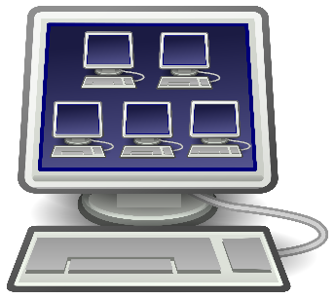
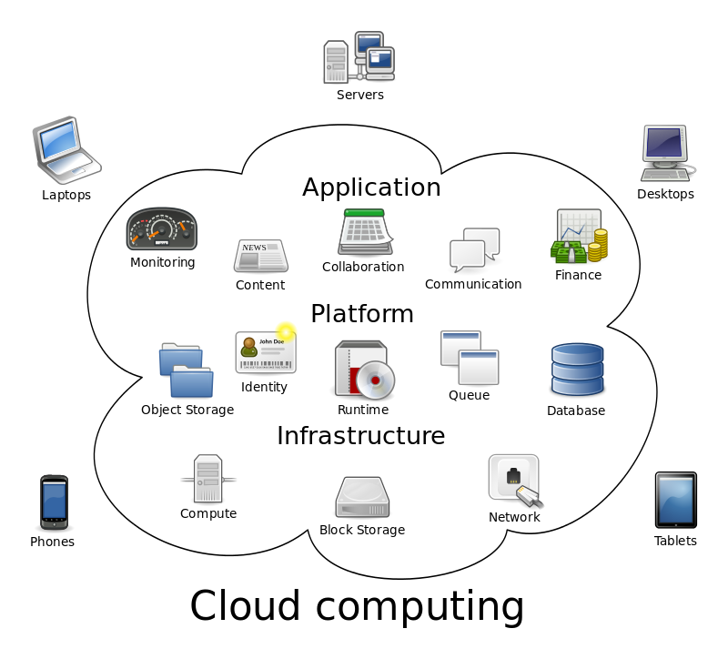
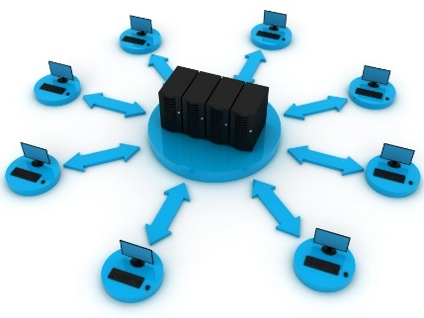
What is Cloud Computing?
Overview
refers to the on-demand delivery of IT resources and applications via the Internet with pay-as-you-go pricing.
provides a simple way to access servers, storage, databases and a broad set of application services over the Internet.
A combination of both Virtualization and Grid, but the end user does not have to care about the underlying architecture
Categories of Cloud Computing
Infrastructure as a Service (IaaS)
Platform as a Service (PaaS)
Software as a Service (SaaS)
Virtualization
One computer acting like many
Grid Computing
Many computers acting like one
Notes:
Cloud Computing is a collection of computing services (compute, storage, network, applications, etc.) accessible on-demand over a network. It is a business and technology model for delivering and acquiring IT services in a utility-like fashion. Pay-as-you go pricing means that the resources can be commissioned or decommissioned anytime you want, you only pay for the exactly amount of time the resources has been used.
Cloud Computing addresses many of the limitations of traditional, on premise IT infrastructure. Cloud computing provides customers with access to remote computing resources, delivered as a service, over the internet. With cloud computing, customers no longer have to purchase and maintain the hardware required to roll out new business applications. Instead, cloud computing allows developers to access computing resources remotely, at any time, through a web browser or through APIs.
Utility computing is a service provisioning model in which a service provider makes computing resources and infrastructure management available to the customer as needed, and charges them for specific usage rather than a flat rate.

Slide 6
What is Cloud Computing?
Overview
Categories of Cloud Computing
Traditional
Infrastructure
as a Service
Platform
as a Service
Software
as a Service
Application
Application
Application
Application
Application Architecture
Application Architecture
Application Architecture
Application Architecture
System Software
System Software
System Software
System Software
Database
Database
Database
Database
Operating System
Operating System
Operating System
Operating System
Virtualization
Virtualization
Virtualization
Virtualization
Servers
Servers
Servers
Servers
Storage
Storage
Storage
Storage
Network
Network
Network
Network
Consumer Managed
Provider Managed
Notes:
Cloud Computing is a collection of computing services (compute, storage, network, applications, etc.) accessible on-demand over a network. It is a business and technology model for delivering and acquiring IT services in a utility-like fashion. Pay-as-you go pricing means that the resources can be commissioned or decommissioned anytime you want, you only pay for the exactly amount of time the resources has been used.
Cloud Computing addresses many of the limitations of traditional, on premise IT infrastructure. Cloud computing provides customers with access to remote computing resources, delivered as a service, over the internet. With cloud computing, customers no longer have to purchase and maintain the hardware required to roll out new business applications. Instead, cloud computing allows developers to access computing resources remotely, at any time, through a web browser or through APIs.
Utility computing is a service provisioning model in which a service provider makes computing resources and infrastructure management available to the customer as needed, and charges them for specific usage rather than a flat rate.

Slide 7
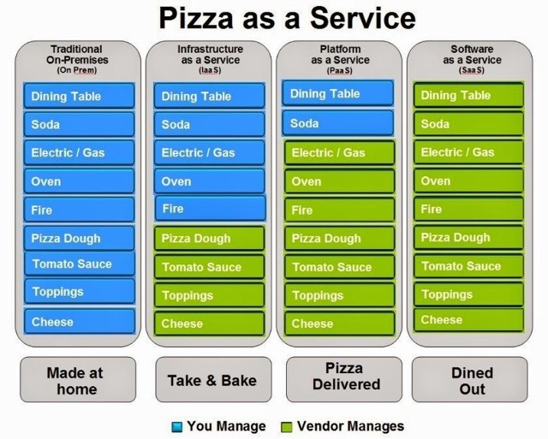
What is Cloud Computing?
Overview
Categories of Cloud Computing
Notes:
Cloud Computing is a collection of computing services (compute, storage, network, applications, etc.) accessible on-demand over a network. It is a business and technology model for delivering and acquiring IT services in a utility-like fashion. Pay-as-you go pricing means that the resources can be commissioned or decommissioned anytime you want, you only pay for the exactly amount of time the resources has been used.
Cloud Computing addresses many of the limitations of traditional, on premise IT infrastructure. Cloud computing provides customers with access to remote computing resources, delivered as a service, over the internet. With cloud computing, customers no longer have to purchase and maintain the hardware required to roll out new business applications. Instead, cloud computing allows developers to access computing resources remotely, at any time, through a web browser or through APIs.
Utility computing is a service provisioning model in which a service provider makes computing resources and infrastructure management available to the customer as needed, and charges them for specific usage rather than a flat rate.

Slide 8

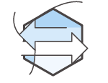
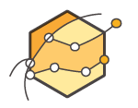



What is Cloud Computing?
Benefits
Benefit from massive economies of scale
Trade capital expense for variable expense
Stop guessing capacity
Cloud Computing
Go global in minutes
Increase speed and agility
Stop spending money on running and maintaining data centers
Notes:
Trade capital expense for variable expense
Instead of having to invest heavily in data centers and servers before you know how you’re going to use them, you can only pay when you consume computing resources, and only pay for how much you consume.
Benefit from massive economies of scale
By using cloud computing, you can achieve a lower variable cost than you can get on your own. Because usage from hundreds of thousands of customers are aggregated in the cloud, providers such as Amazon Web Services can achieve higher economies of scale which translates into lower pay as you go prices.
Stop guessing capacity
Eliminate guessing on your infrastructure capacity needs. When you make a capacity decision prior to deploying an application, you often either end up sitting on expensive idle resources or dealing with limited capacity. With Cloud Computing, these problems go away. You can access as much or as little as you need, and scale up and down as required with only a few minutes notice.
Increase speed and agility
In a cloud computing environment, new IT resources are only ever a click away, which means you reduce the time it takes to make those resources available to your developers from weeks to just minutes. This results in a dramatic increase in agility for the organization, since the cost and time it takes to experiment and develop is significantly lower.
Stop spending money on running and maintaining data centers
Focus on projects that differentiate your business, not the infrastructure. Cloud computing lets you focus on your own customers, rather than on the heavy lifting of racking, stacking and powering servers.
Go global in minutes
Easily deploy your application in multiple regions around the world with just a few clicks. This means you can provide a lower latency and better experience for your customers simply and at minimal cost.

Slide 9
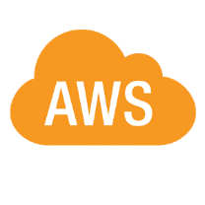
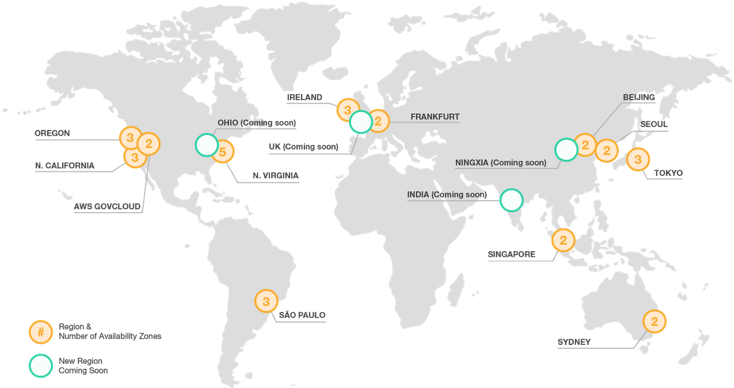
What is Amazon Web Services?
Overview
Provides computing resources and services that you can use to build applications within minutes.
Operate from 13 geographical regions across the world.
has more than 70 services that span a wide range including compute, storage, networking, database, analytics, application services, deployment, management, mobile, developer tools and tools for the Internet of things.
The most central and best-known of these services arguably include Amazon Elastic Compute Cloud (EC2) and Amazon Simple Storage Service (S3).
Notes:
So lets look at Amazon Web Services, AWS started with the vision of making everything as a web service. It launched in 2006 when it when it began offering developer access to IT infrastructure in the form of web services – now commonly known as cloud computing. Amazon Web Services (AWS) provides computing resources and services that you can use to build applications within minutes at pay-as-you-go pricing. Pay-as-you go pricing means that the resources can be commissioned or decommissioned anytime you want, you only pay for the exactly amount of time the resources has been used.
Low Cost- Building on-premise infrastructure can be slow and expensive. Many components need to be in place before you or your customer can run applications. With AWS, customers can have servers running in minutes. AWS offers low, pay-as-you-go pricing with no up-front expenses or long-term commitments.
Agility and Instant Elasticity- Elasticity is the power to scale computing resources up and down easily, while only paying for actual resources used. The elasticity provides –Quickly deploy new applications, Instantly scale up as the workload grows, instantly shut down resources that are no longer required
Open and Flexible- AWS is language and operating system agnostic platform. Customers choose the development platform or programming model that makes the best sense for their business.
Secure- AWS is secure, durable technology platform. AWS build services in accordance with security best practices, provides appropriate security features in those services, and documents how to use those features.

Slide 10
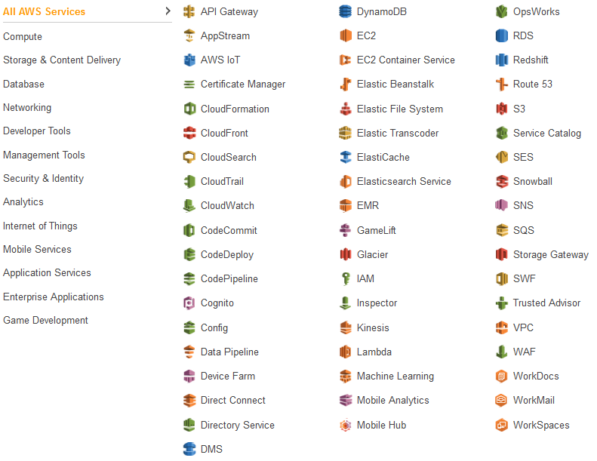
What is Amazon Web Services?
Services

Slide 11
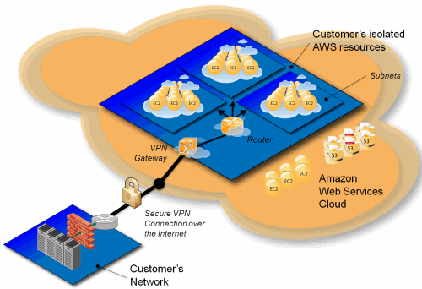
What is Amazon Web Services?
Overview
What is Amazon VPC?
Amazon Virtual Private Cloud (Amazon VPC) enables you to launch Amazon Web Services (AWS) resources into a virtual network that you've defined. This virtual network closely resembles a traditional network that you'd operate in your own data center, with the benefits of using the scalable infrastructure of AWS.
What Is Amazon EC2 Instance?
Amazon EC2 provides virtual computing environments known as instances. An EC2 instance is a virtual server in Amazon’s Elastic Compute Cloud (EC2) for running applications on the Amazon Web Services (AWS) infrastructure.
What Is Amazon S3?
Amazon S3 has a simple web services interface that you can use to store and retrieve any amount of data, at any time, from anywhere on the web. It gives any developer access to the same highly scalable, reliable, fast, inexpensive data storage infrastructure that Amazon uses to run its own global network of web sites.

Slide 12
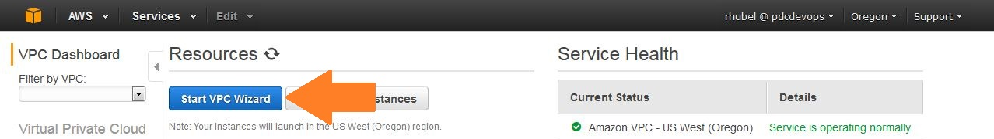
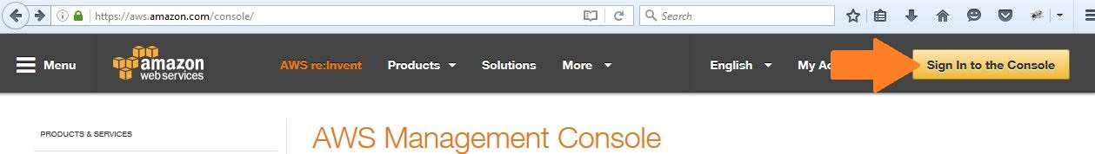
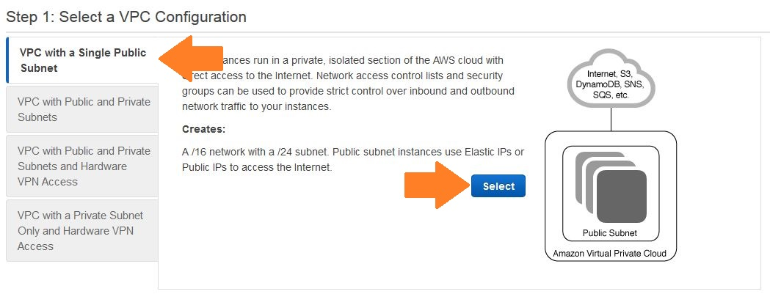
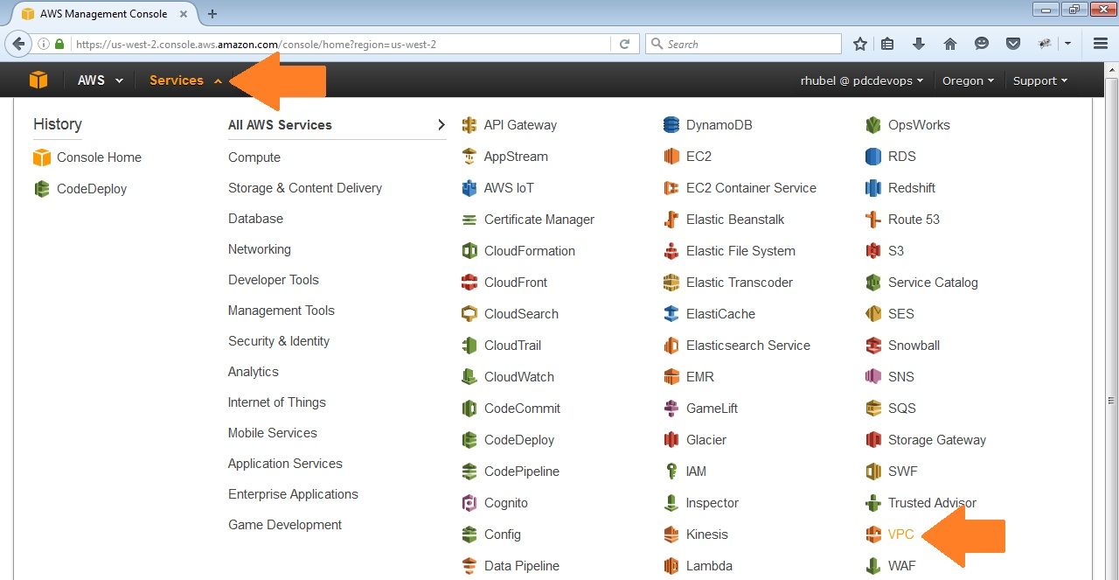
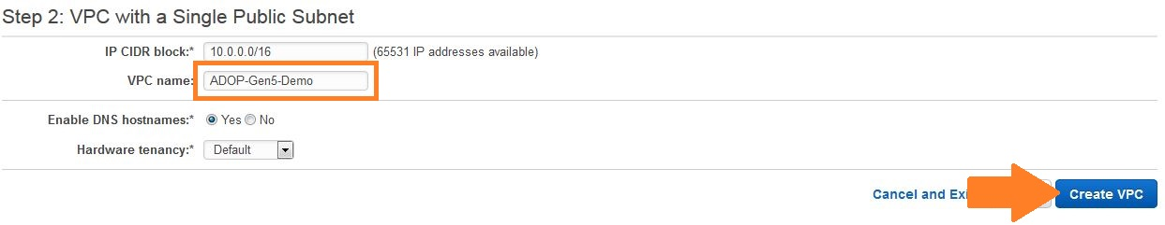
Virtual Private Cloud
Creating a VPC
Click ‘Start VPC Wizard’.
Navigate to https://aws.amazon.com/console . Click ‘Sign In to the Console’ and Login.
Select ‘VPC with a Single Public Subnet’ as a VPC Configuration. Click Select.
Click ‘Services’ and choose ‘VPC’
Type a VPC name and Click Create VPC.

Slide 13
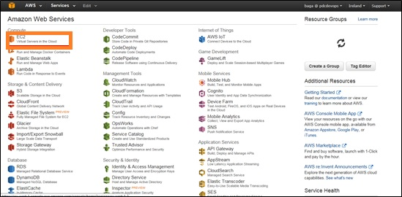
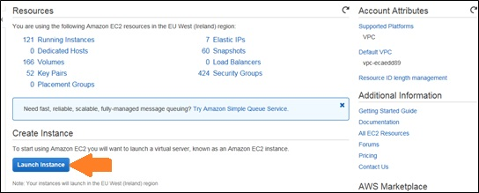
EC2 Instance
Creating an EC2 Instance
On Services, choose ‘EC2’.
Click ‘Launch Instance’.

Slide 14
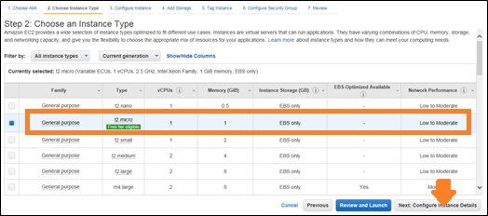
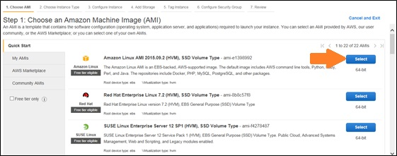
Elastic Compute Cloud
Creating an EC2 Instance
Follow the steps in creating an EC2 Instance with the following configurations:
Instance Type: t2 micro
Amazon Machine Image: Amazon Linux

Slide 15
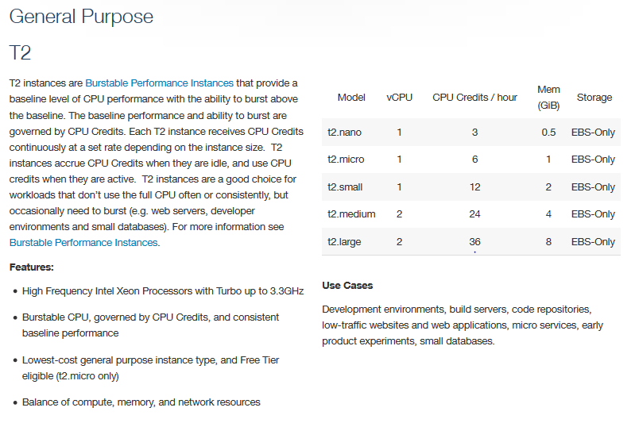
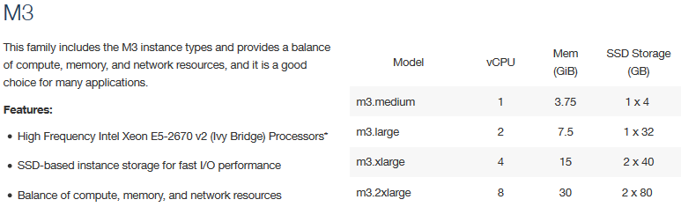
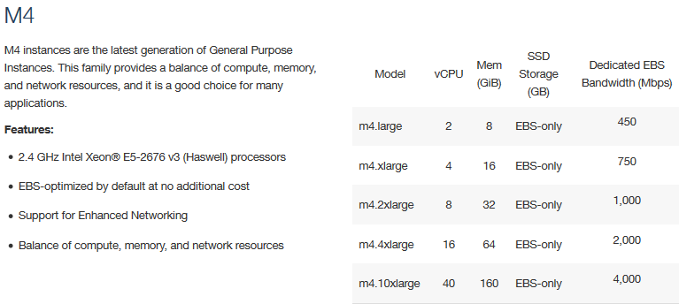
Elastic Compute Cloud
Creating an EC2 Instance
Types of Instances:

Slide 16
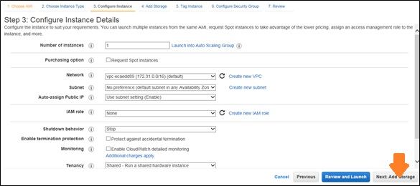
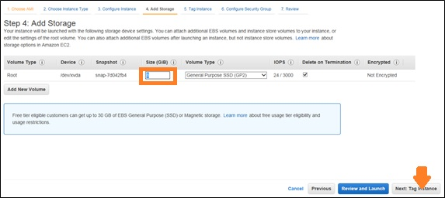
Elastic Compute Cloud
Creating an EC2 Instance
Instance Details: default
Storage Size: 8 GB

Slide 17
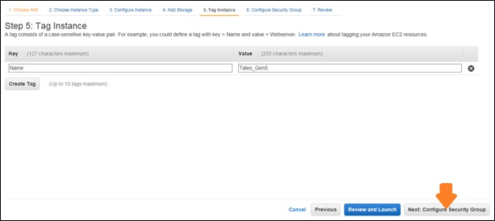
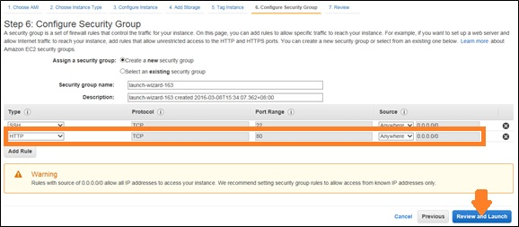
Elastic Compute Cloud
Creating an EC2 Instance
Add the following key and value pair for the Tag:
Click ‘Add Rule’ and choose HTTP from the Type to enable Port:80 for running the application on the browser.

Slide 18
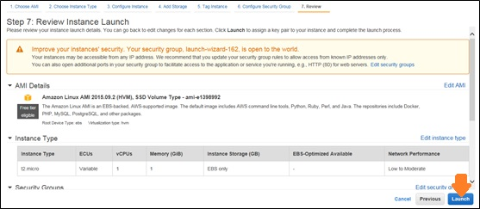
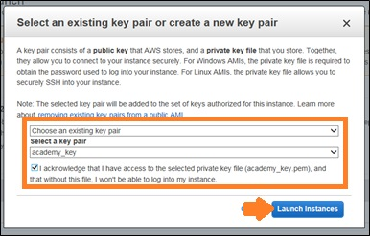
Elastic Compute Cloud
Creating an EC2 Instance
Review the created EC2 Instance configurations.
A pop-up will appear prompting you to choose select a key pair. Select ‘Choose an existing key pair’ and ‘academy_key’ and check the acknowledgement message.

Slide 19
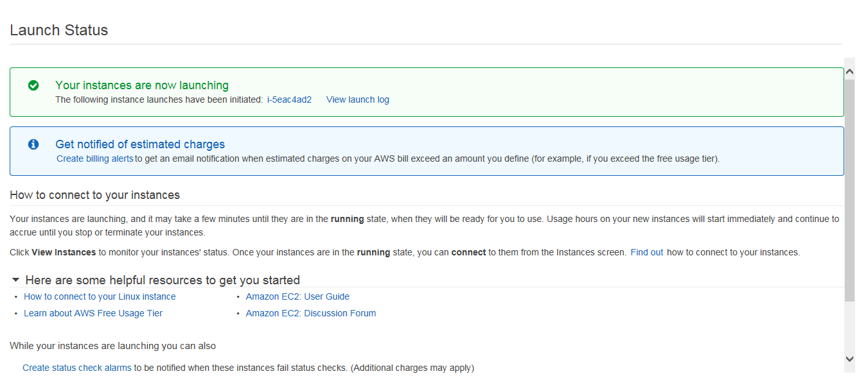
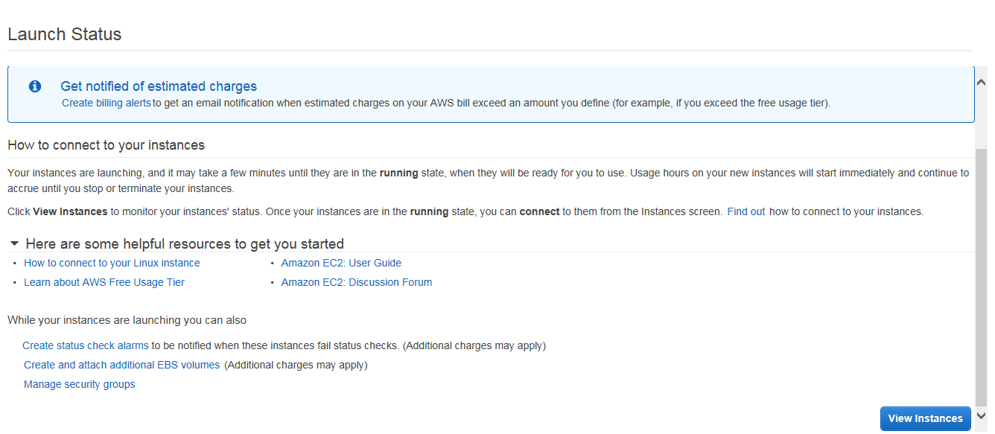
Elastic Compute Cloud
Creating an EC2 Instance
When done, click the ‘Launch Instances’ button and you will see the following message:

Slide 20
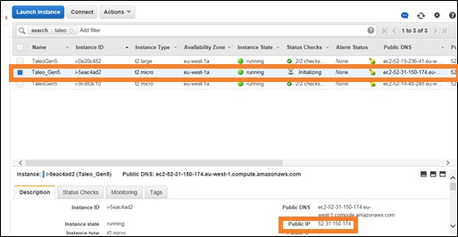
Elastic Compute Cloud
Creating an EC2 Instance
Search the newly created EC2 instance under Instances and copy the Public IP.

Slide 21
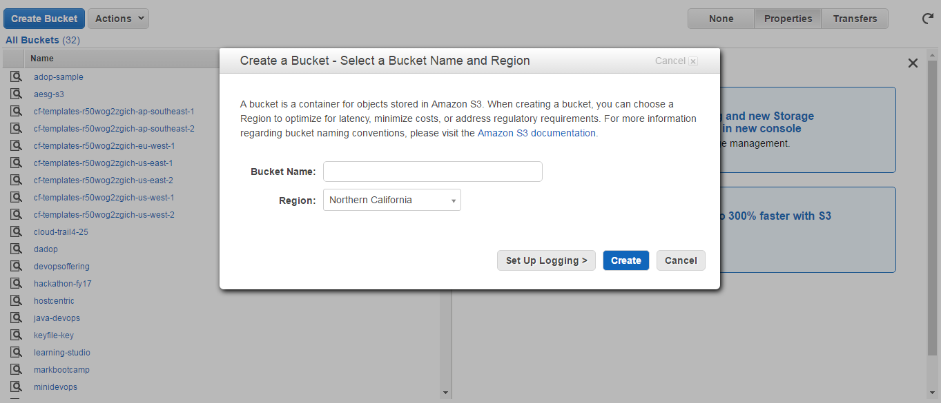
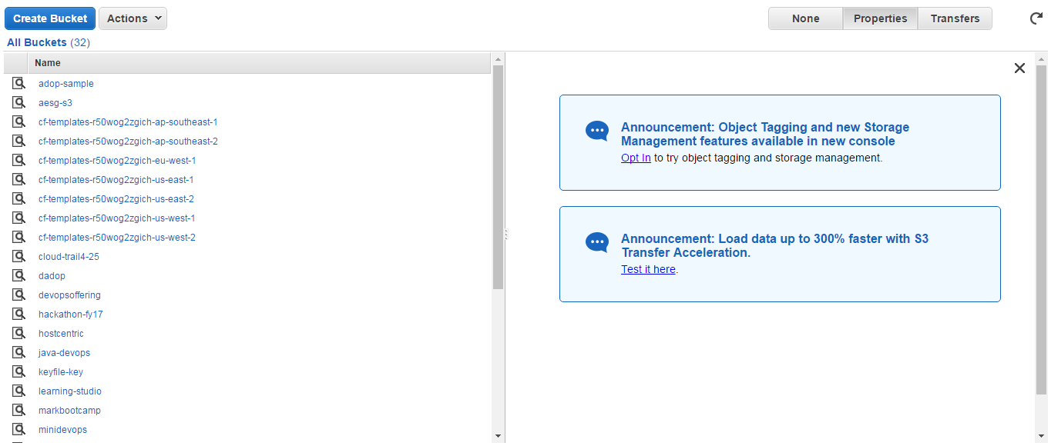
Simple Storage Service
Creating a S3 bucket

Slide 22
Simple Storage Service
Creating a S3 bucket

Slide 23

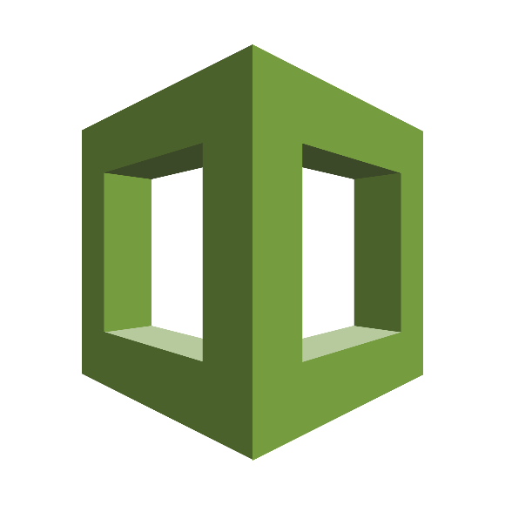

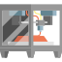
What is AWS CloudFormation?
Overview
AWS CloudFormation gives developers and systems administrators an easy way to create and manage a collection of related AWS resources, provisioning and updating them in an orderly and predictable fashion.
CloudFormation enables users to model and version control the architecture they want in the CloudFormation template files.
The CloudFormation service can automatically create the desired architecture (CloudFormation stacks) from the template files, without burdening the users with writing complex provisioning code.

Slide 24
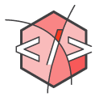
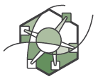
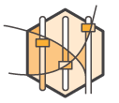
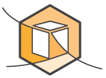
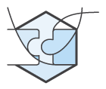


What is AWS CloudFormation?
Benefits
Infrastructure as Code
Supports a Wide Range of AWS Resources
Customized via Parameters
AWS
CloudFormation
Easy to Use
Integration Ready
Declarative and Flexible
Visualize and Edit with Drag-and-Drop Interface
Notes:
Supports a Wide Range of AWS Resources
AWS CloudFormation supports a wide range of AWS resources, allowing you to build a highly available, reliable, and scalable AWS infrastructure for your application needs.
Easy to Use
CloudFormation makes it easy to organize and deploy a collection of AWS resources and lets you describe any dependencies or special parameters to pass in at runtime. You can use one of the many CloudFormation sample templates -- either verbatim or as a starting point.
Declarative and Flexible
To create the infrastructure you want, you enumerate what AWS resources, configuration values, and interconnections you need in a template and then let AWS CloudFormation do the rest with a few simple clicks in the AWS Management Console, one command by using the AWS command line interface, or a single requests by calling the APIs. You won’t have to recall the details of how to create and interconnect the respective AWS resources via their service APIs; AWS CloudFormation does this for you. You also don’t need to write a template from scratch if you start with one of the many sample templates that come with AWS CloudFormation.
Infrastructure as Code
A template can be used repeatedly to create identical copies of the same stack (or to use as a foundation to start a new stack). You can capture and control region-specific infrastructure variations such as Amazon EC2 AMIs, as well as Amazon EBS and Amazon RDS snapshot names. Templates are simple JSON-formatted text files that can be placed under your normal source control mechanisms, stored in private or public locations such as Amazon S3, and exchanged via email. With AWS CloudFormation, you can "open the hood," to see exactly which AWS resources make up a stack. You retain full control and have the ability to modify any of the AWS resources created as part of a stack.
Customized via Parameters
You can use parameters to customize aspects of your template at run time, when the stack is built. For example, you can pass the RDS database size, EC2 instance types, database, and web server port numbers to AWS CloudFormation when you create a stack. You can also use a parameterized template to create multiple stacks that may differ in a controlled way. For example, your Amazon EC2 instance types, Amazon CloudWatch alarm thresholds, and Amazon RDS read-replica settings may differ among AWS regions if you receive more customer traffic in the US than in Europe. You can use template parameters to tune the settings and thresholds in each region separately and still be sure that the application is deployed consistently across the regions.
Visualize and Edit with Drag-and-Drop Interface
AWS CloudFormation Designer provides a visual diagram of your template with icons representing your AWS resources and arrows showing their relationships. You can build and edit templates using the drag-and-drop interface, then edit the template details using the integrated JSON text editor. CloudFormation Designer allows you to spend more time designing your AWS infrastructure and less time manually coding your templates.
Integration Ready
You can integrate AWS CloudFormation with the development and management tools of your choice.
AWS CloudFormation publishes progress events through the Amazon Simple Notification Service (SNS). With SNS, you can track stack creation and deletion progress via email and integrate with other processes programmatically.

Slide 25




What is AWS CloudFormation?
Architecture
Stack
Template

Slide 26




What is AWS CloudFormation?
Architecture
Template

Slide 27






What is AWS CloudFormation?
Architecture
Template
Cloud Formation
Generated Stack
Desired Architecture
Comprehensive service support
Service event aware
Customizable
Conceptualization
Architecture Layout
Parameter definition
Resource creation
Configuration actions
Stack creation
Stack updates
Error Detection and rollback

